Slide 1





Processing large social media datasets on HAWK
Sefa Ozalp
Data Science Researcher, HateLab
12 February 2020
ARC HPC Research Seminar
@SefaOzalp

Slide 2

https://papers.ssrn.com/sol3/papers.cfm?abstract_id=3532492

Slide 3
The Number of All Tweets vs Antagonistic Tweets

Slide 4
The Number of Antagonistic Tweets

Slide 5
Antisemitic Tweet Classification Results
Event 1
Event 2
Event 3

Slide 6
Technology Stack

Slide 7
Data Collection
Data collected from Twitter stream filter API using keywords of interest. We use COSMOS software developed by Social Data Science Lab http://socialdatalab.net/COSMOS.
A dataset I’m collecting since November 2016 using keywords:
‘muslim, muslims, islam, refugee, refugees, immigrant, immigrants, immigration, migrants, migrant, migration, jew, jews’
Data comes in hourly .jsonl chunks, ranges between 4.3 Mb on disk and 1.2 GBs on disk.

Slide 8
Problem with Large Twitter Data (For a social scientist)
Json data are hierarchical (strong dislike).
Parsing data into 2D tabular format takes really long.
When parsing, Json objects tend to expand in memory (by a factor of 20)
Flattened tweet object can contain more than 3500 columns.
A tweet json object can contain thousands of fields (demo in VS code)

Slide 10
How large is large enough?
27296 hourly chunks.
Total size of the data are 6.6TB
Total number of tweets are 1124710581 (rough estimate)

Slide 11


Slide 12
HAWK to the rescue.
Pushing data to SCW servers
Writing my own functions and then eventually my own R package rather than calling writing interactive scripts (gosh).
https://github.com/sefabey/tweetWrangleR/ (still fails travis CI though)
Use highmem cluster on HAWK and handle parallelisation in R using {furrr} package.

Slide 13
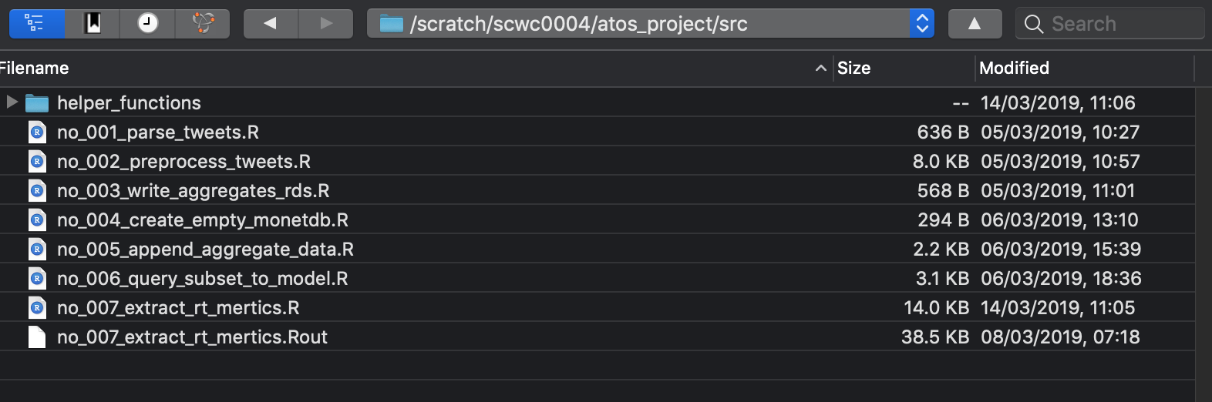

Slide 14
#!/usr/bin/env Rscript
args = commandArgs(trailingOnly=TRUE) # input is monthly folder
library(tidyverse)
library(furrr)
library(tweetWrangleR)
month_folder <- args[1]
file_paths <- fs::dir_ls(month_folder, glob = "*.jsonl", recursive=T) %>%
sample(replace = F)
plan(multiprocess(workers = 20)) # run on 20 cores
options(future.globals.maxSize= 20000*1024^2)
tictoc::tic()
future_map(file_paths,
tweetWrangleR::parse_jsonl,
export_as_csv=TRUE,
export_as_rds=TRUE)
tictoc::toc()

Slide 15
#!/bin/bash
#SBATCH -J scw1283
#SBATCH --nodes=1
#SBATCH -o output-%A.o
#SBATCH --mem 150
#SBATCH --ntasks-per-node=40
#SBATCH --time=00:59:00
#SBATCH -p dev
#SBATCH --mail-type=ALL
#SBATCH --mail-user=ozalpas@cardiff.ac.uk
#SBATCH --job-name=atos-01
module purge
module load R/3.5.1
Rscript /scratch/scwc0004/atos_project/src/no_001_parse_tweets.R /scratch/scwc0004/atos_project/data/2018_06

Slide 16
Benefits of using HAWK
Enabling us to process wrangle enormous amounts of data, in parallel. This was previously impossible to do with our existing computing infrastructure.
Faster experimentation with large datasets.
Faster results by a factor of 120.
Statistical modelling larger datasets using highmem cluster.

Slide 17
Future Work
- Distribute workload across more nodes
Profiling and benchmarking code
More importantly, try my hand at GPU accelerated computing, in particular RAPIDS and DASK (please?).

Slide 18
Useful Links
R code to parse jsonl files:
https://gist.github.com/sefabey/edb4fb36b281e4072deadb679e5a2863
Slurm script to run the R code:
https://gist.github.com/sefabey/55987ec9deb328ff3b2b2c036eb97702
TweetWrangler Package:
https://github.com/sefabey/tweetWrangleR/
Data and analysis used for this presentation
https://sefabey.github.io/ARCCA_HPC_seminar/docs/identity_dataset.html
Antisemitism Paper
https://papers.ssrn.com/sol3/papers.cfm?abstract_id=3532492

Slide 19
Processing large social media datasets on HAWK
Sefa Ozalp
Data Science Researcher, HateLab
11 February 2020
ARC HPC Research Seminar
@SefaOzalp

